Slide 1
Time Series Analysis: Pizza Sales SeAN KENNEDY, SMU
Large PIZZA DELIVERY CHAIN
CREDIT CARD SALES DATA
DAILY FREQUENCY
7 YEAR HISTORY (2013-2020)
This analysis will benefit my firm as a useful predictor of the same store sales KPI as credit card data is strongly correlated to this metric
The analysis could also benefit companies in the restaurant industry that wish to analyze the change in spending trends as a result of COVID
See github repo for further details on data collection and fields
https://github.com/ethereum-ninja/SMU/tree/master/Time%20Series/project

Slide 2
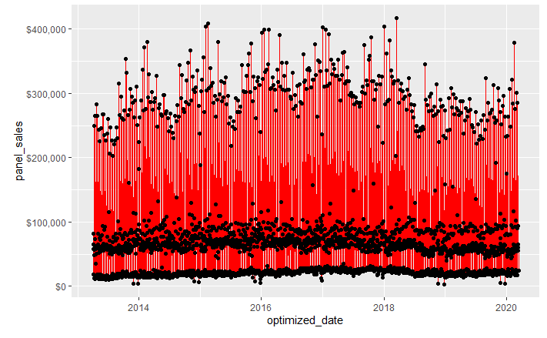
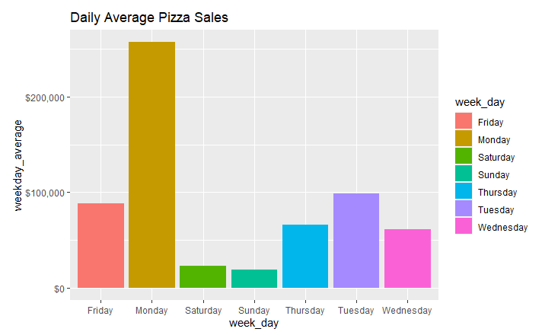
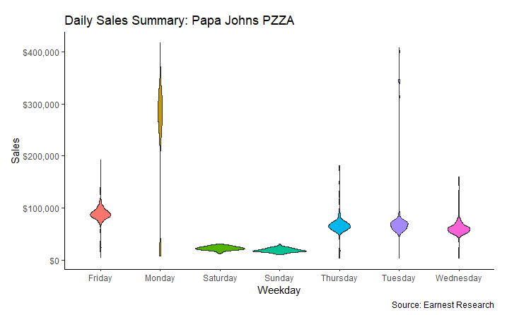
Stationarity
Data is clearly non-stationary. Mean depends on time – as it should – there should be observable social trends that make certain days more likely than others.
From the violin plots, we can see that variance is also not constant.

Slide 3
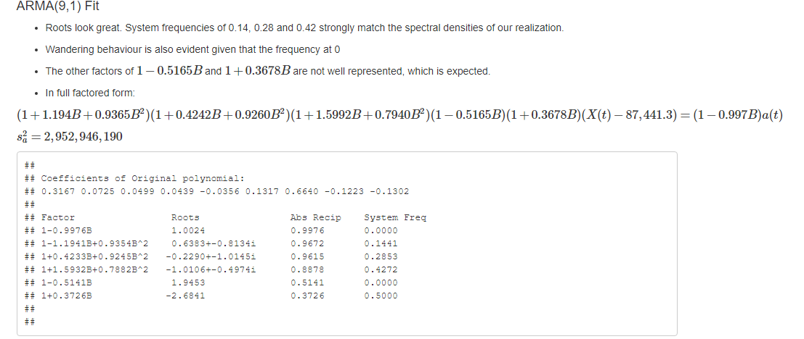
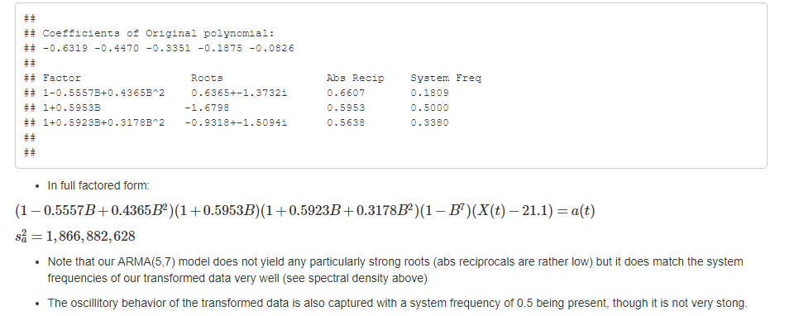
Model SELECTION
ARMA(9,1): FavoreD by BIC
ARUMA(5,0,7) s=7: FAVORED BY BIC

Slide 4
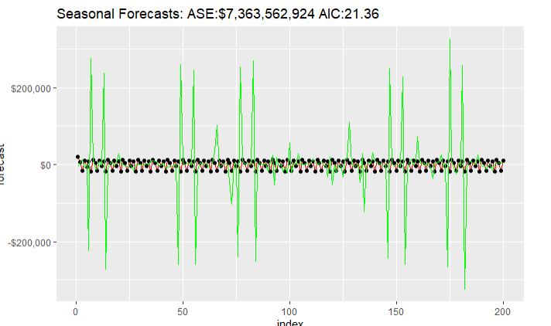
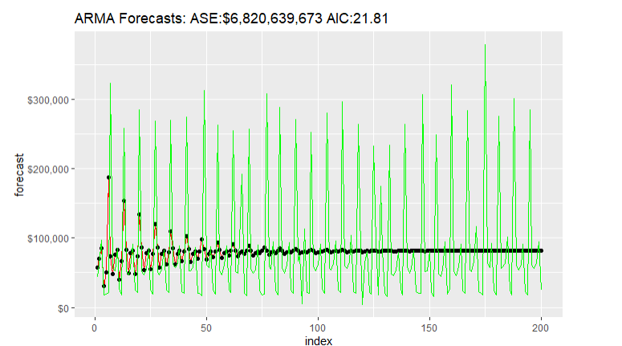
Forecasts
ARMA(9,2)
ARUMA(5,0,7) S=7
ARMA wins on AIC/ASE
ARUMA has a longer term horizon for accurate predictions
ARMA captures shorter term trends, but decays to mean after about 55 days

Slide 5
Conclusion / Further ANALYSIS
ARMA models appears to capture short term cyclical trends better - but has a shorter useful prediction horizon. Could be useful to try an ARMA(9,0)
Further analysis
Other vendors (pizza, other delivery chains)
Other verticals (non-restaurant)
Monthly, weekly aggregation

